Slide 1
FORL 1060:
Zasechnaya Cherta, Russia
Daphna Laveus
Lucas Meinken
Reena Patel
Cristian Rosales
Chelsea Silvia

Slide 2

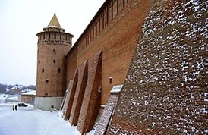
Introduction
“Zasechnaya Cherta, loosely translated as the Great Abatis Line, serves defense fortification on the southern frontier of the Russian state. The Abatis was built in 1566, but not guarded until the latter half of the 16th century, when the Crimean-Nogai Raids rapidly moved along the Muravsky Trail, ravaging the Southern provinces of Russia.”
Zasechnaya Cherta
Great Abatis Line
1566
Muravsky Trail

Slide 3
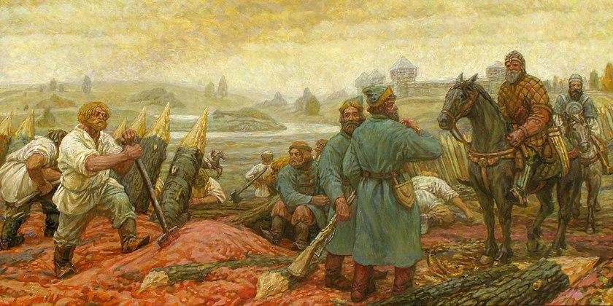
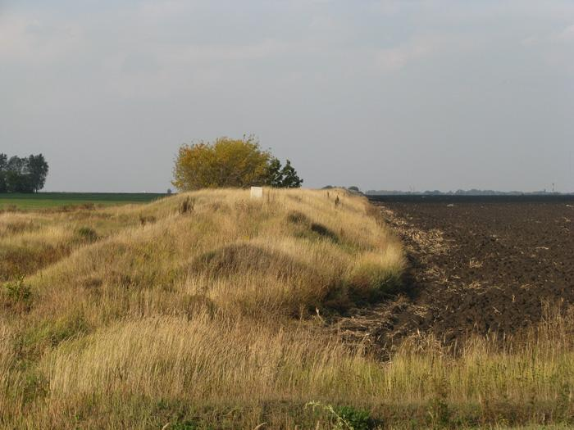
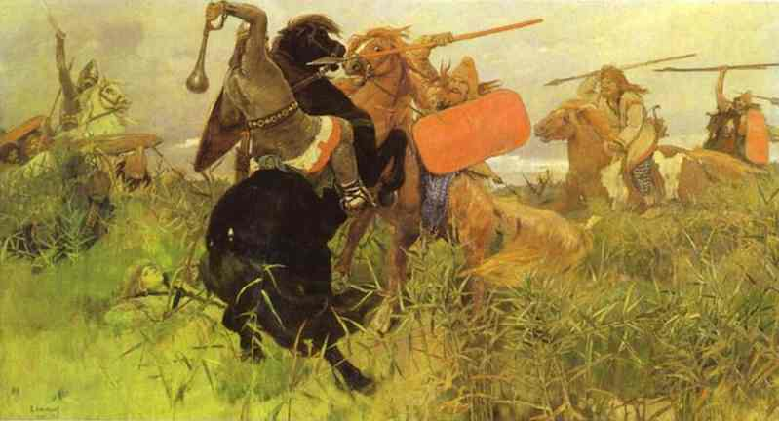
Abatis
“The border ravaged the southern provinces during the Russo-Crimean Wars. The border is similar to the Great Wall of China. The term Abatis means field fortification made by cutting down trees, from which the line was constructed. It was also fortified by earth-mounds, palisades, watchtowers, and even naturally occurring structures, such as lakes and swamps.”
Ravaged
Field Fortification

Slide 4
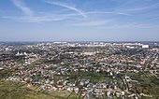
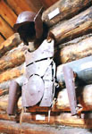
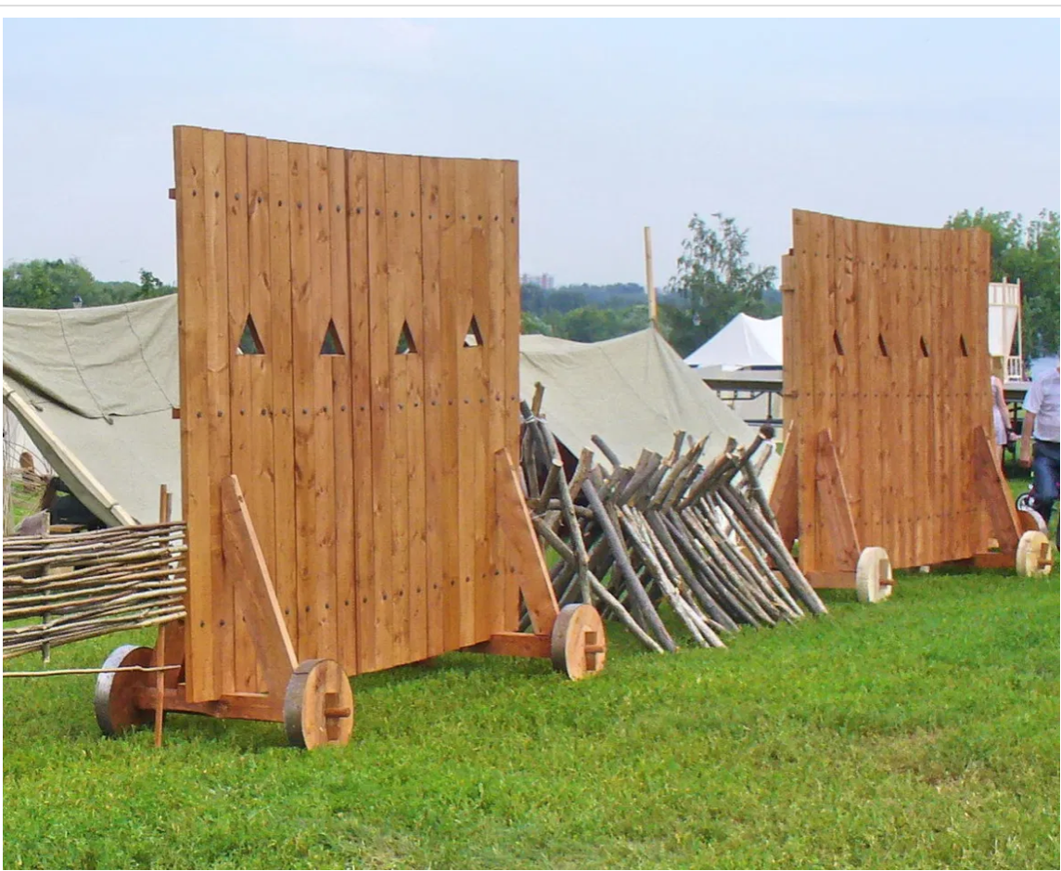
Size & Advancements
“The size of the Abatis is around several hundred meters wide. Gates along the Abatis were created to monitor those who passed by. Nearby peasants were forbidden to chop any trees in the area but were obliged to spend their free time to support the advancements of the defensive wall.”
Several hundred meters wide
Forbidden
Defence wall

Slide 5
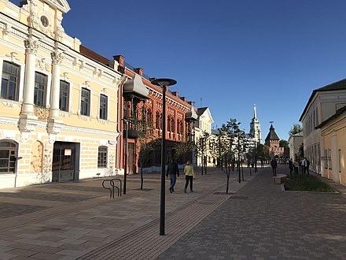
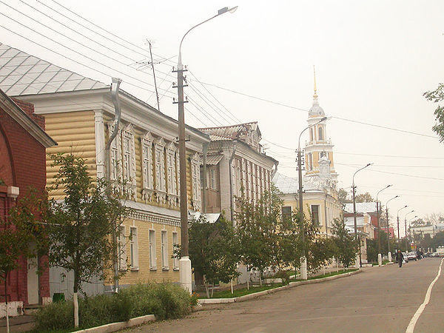
Diminishing Border Use
“As the wars began to fizz out, the use of the border diminished. There are currently no remains of the border, and the area has been covered by the natural landscape and even homes.”
Diminished
No Remains

Slide 6
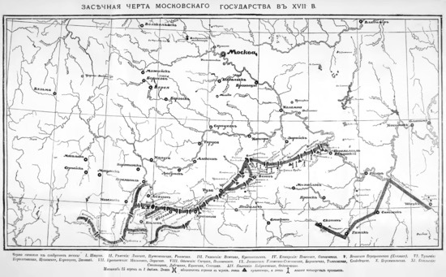
Significant Lines
“The oldest significant line was finished in the time around 1563-1566 and exists from the Nizhny Novgorod along the Oka River to Kozelsk. This line was created by Ivan the Terrible. The next notable line was built quite some time later and followed the line Alatyr – Orel – Novgorod Seversky – Putivl. Feodor I of Russia built the Abatis on the line Livny – Kursk – Voronezh – Belgorod. The Simbirsk line was erected around 1640, which connected the Belgorod line from Tambov to Simbirsk on the Volga River. In the year 1730/31, the Kama line disconnected Kansan from the Bashkirs.”
Oldest significant line
Ivan the terrible
Feodor I of Russia

Slide 7
Explanatory video
https://youtu.be/NLweSJFUDFY

Slide 8
Work Cited
Images
“Great Zasechnaya Cherta.” Wikipedia, Wikimedia Foundation, 1 July 2020, en.wikipedia.org/wiki/Great_Zasechnaya_cherta.

